Slide 1
GNOMES WELL
Chelsea Pascua
Calvin Antonio
De Luna Johwell
Notes:
The objective of the game is to guide a gnome character who is suspended on a rope, swinging across obstacles to reach treasures at the bottom of the well. What makes this game unique is it doesn’t use typical platformer controls — instead, movement depends on mastering a swinging rope that behaves like in real life. The challenge comes from timing swings correctly and avoiding hazards while collecting treasures.

Slide 2
PHASE 1: GETTING STARTED BUILDING THE GAME
PHASE 2: PREPARING FOR GAMEPLAY
PHASE 3: POLISHING THE GAME
Notes:
Unity Demo
Let’s start with a quick demo of the gameplay. As you can see, the game begins with a start screen. Once I press play, the gnome spawns in at the top of the well and the rope mechanics take over.
Gameplay Demonstration:
-I control the game as its allowing me to swing the gnome left and right smoothly.
-The core mechanic is the rope. The gnome swings in an arc, following realistic physics. The player can control the swing’s intensity by alternating inputs. If implemented, I can also detach and reattach the rope, which adds strategy for repositioning.
-At the bottom, there are treasures to collect. When the gnome reaches one, the score increases, and a win condition is triggered. If the gnome hits a hazard or falls outside the play area, the lose condition activates. Once a level is complete, I can advance to the next level.

Slide 3
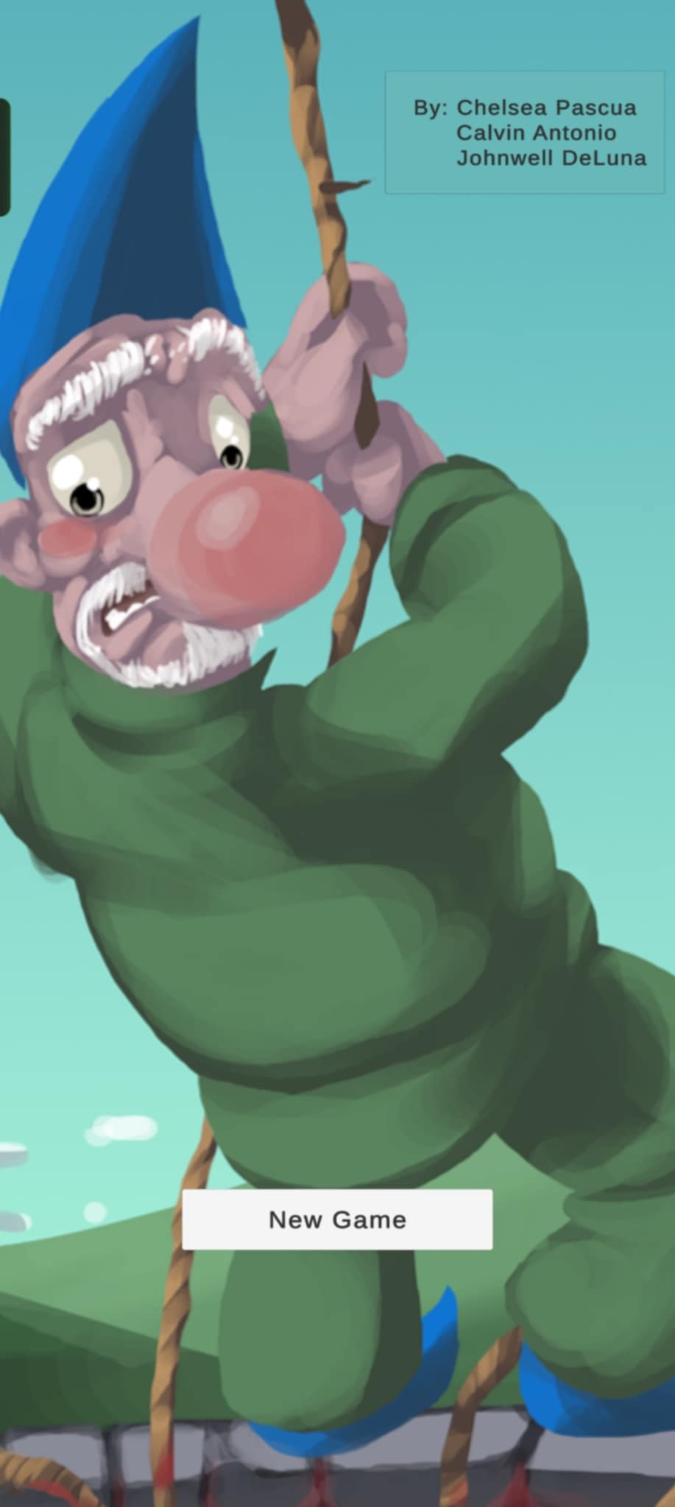
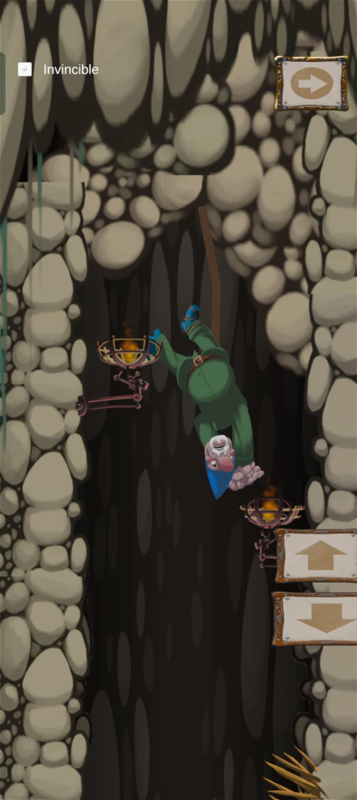
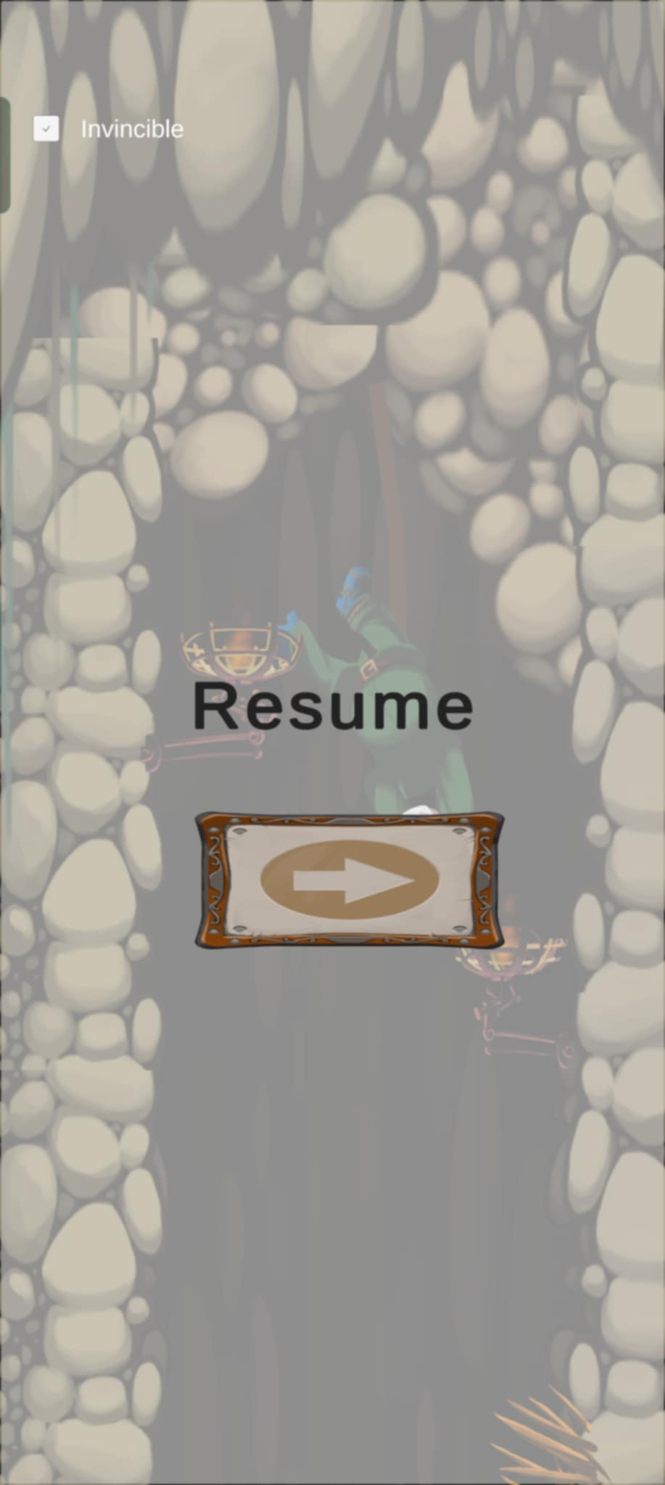
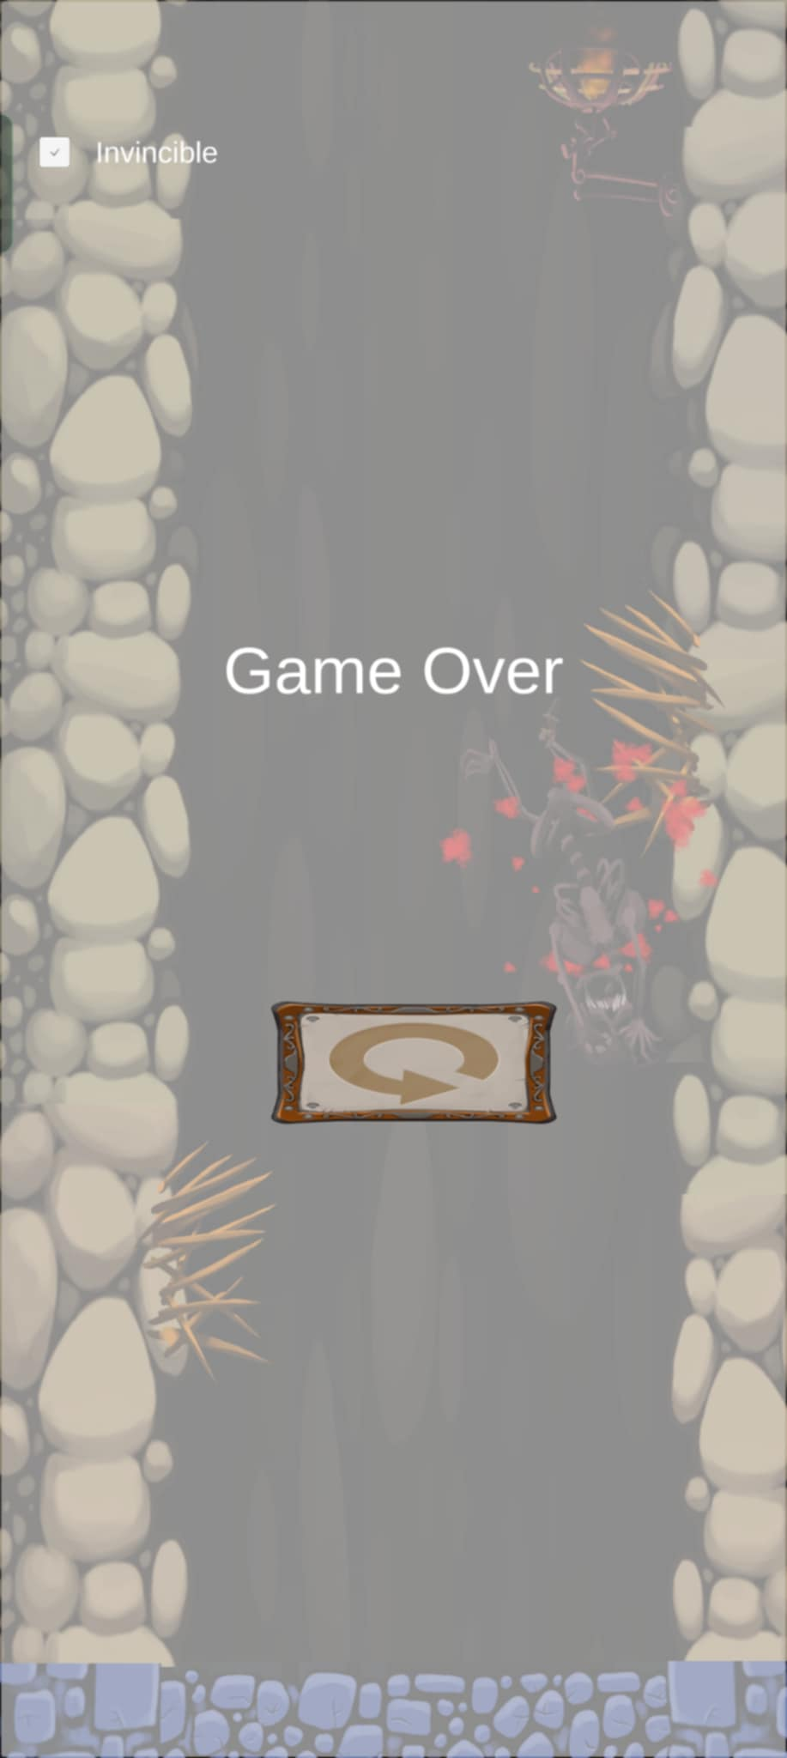
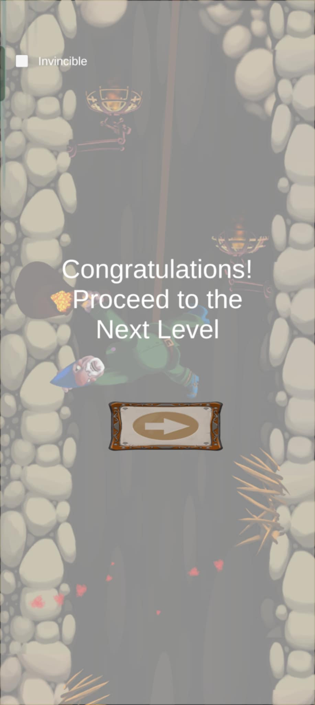
Notes:
Here’s the UI demonstration:
Start screen with a play button.
Pause menu accessible during gameplay.
Game over screen if I fail.
Congratulations screen if I win a level, with an option to continue to the next level.

Slide 4
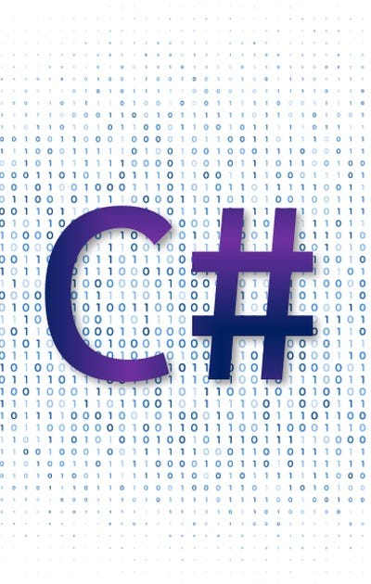
GameManager.cs
CameraFollow.cs
InputManager.cs
LevelManager.cs
SignalOnTouch.cs
Resettable.cs
Swinging.cs / RopeController.cs
Notes:
I will only be explaining the core scripts that make this game function. These are the backbone systems that handle game flow, input, rope mechanics, and resets
1. GameManager.cs
The GameManager acts as the central controller. It coordinates high-level game states such as start, pause, game over, and win conditions. This ensures the game always transitions smoothly between states without conflicts.
2. CameraFollow.cs
The CameraFollow script keeps the camera focused on the gnome while maintaining a stable frame. It uses smoothing to avoid jittery motion and safety checks so the camera doesn’t snap out of bounds.
3. InputManager.cs
The InputManager centralizes all player inputs. Instead of scattering input detection across multiple scripts, this script translates key presses or controller input into standardized commands. This improves maintainability and makes future control changes much easier.
4. LevelManager.cs
The LevelManager handles level transitions. When a level is complete, it checks the current scene index, loads the next one, or ends the game if there are no more levels available. This prevents crashes if a scene is missing and gives a clear flow to progression.
5. SignalOnTouch.cs
SignalOnTouch is a utility script that triggers events when the gnome collides with certain objects, such as treasure or hazards. This is how the game recognizes scoring actions or failure conditions.
6. Swinging.cs / RopeController.cs
The Swinging script controls the rope mechanics. It calculates the physics of swinging, responds to input for momentum, and applies constraints so the rope never stretches beyond its intended length. This is the core mechanic that makes the game unique.
7. Resettable.cs
Resettable is a helper script that ensures certain objects return to their default state when the level is restarted. This prevents bugs like hazards staying destroyed or treasures remaining collected between retries.
Together, these scripts form the foundation of Gnome Well. They handle everything from input to rope physics, game state management, and scene transitions. While there are additional helper scripts, these are the core systems that make the game work.

Slide 5
Conclusion
Currently, the game is fully playable with functional rope physics, scoring, and level progression. However, there are limitations: the rope mechanics could be refined for smoother control, and the game only has two levels so far. Next steps include adding more hazards, power-ups, and additional levels to increase replay value.
That concludes my demo.

